Slide 1
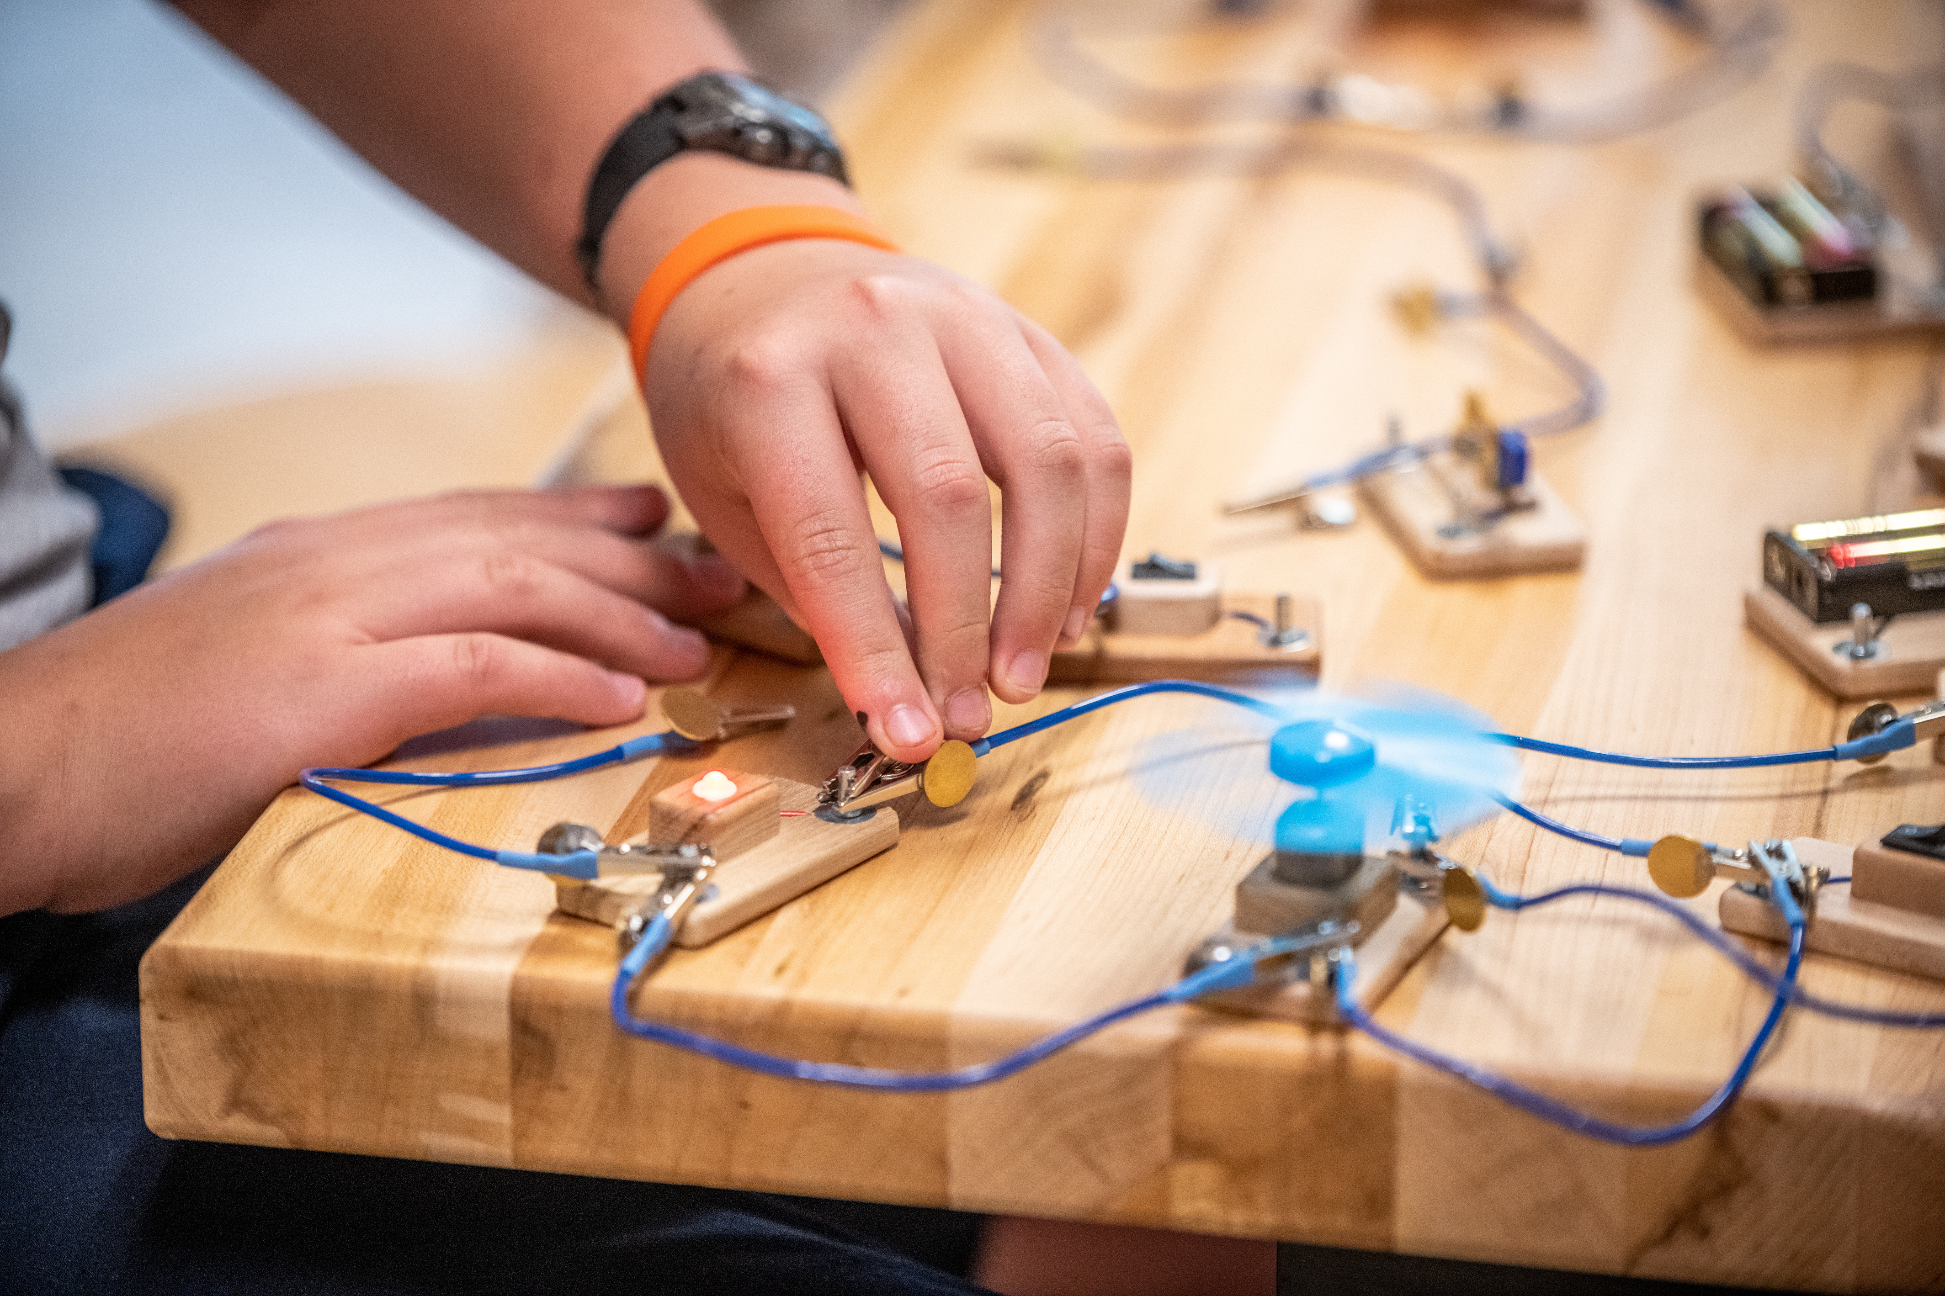

KID MUSEUM // ARLINGTON PUBLIC SCHOOLS
November 21, 2025

Slide 2
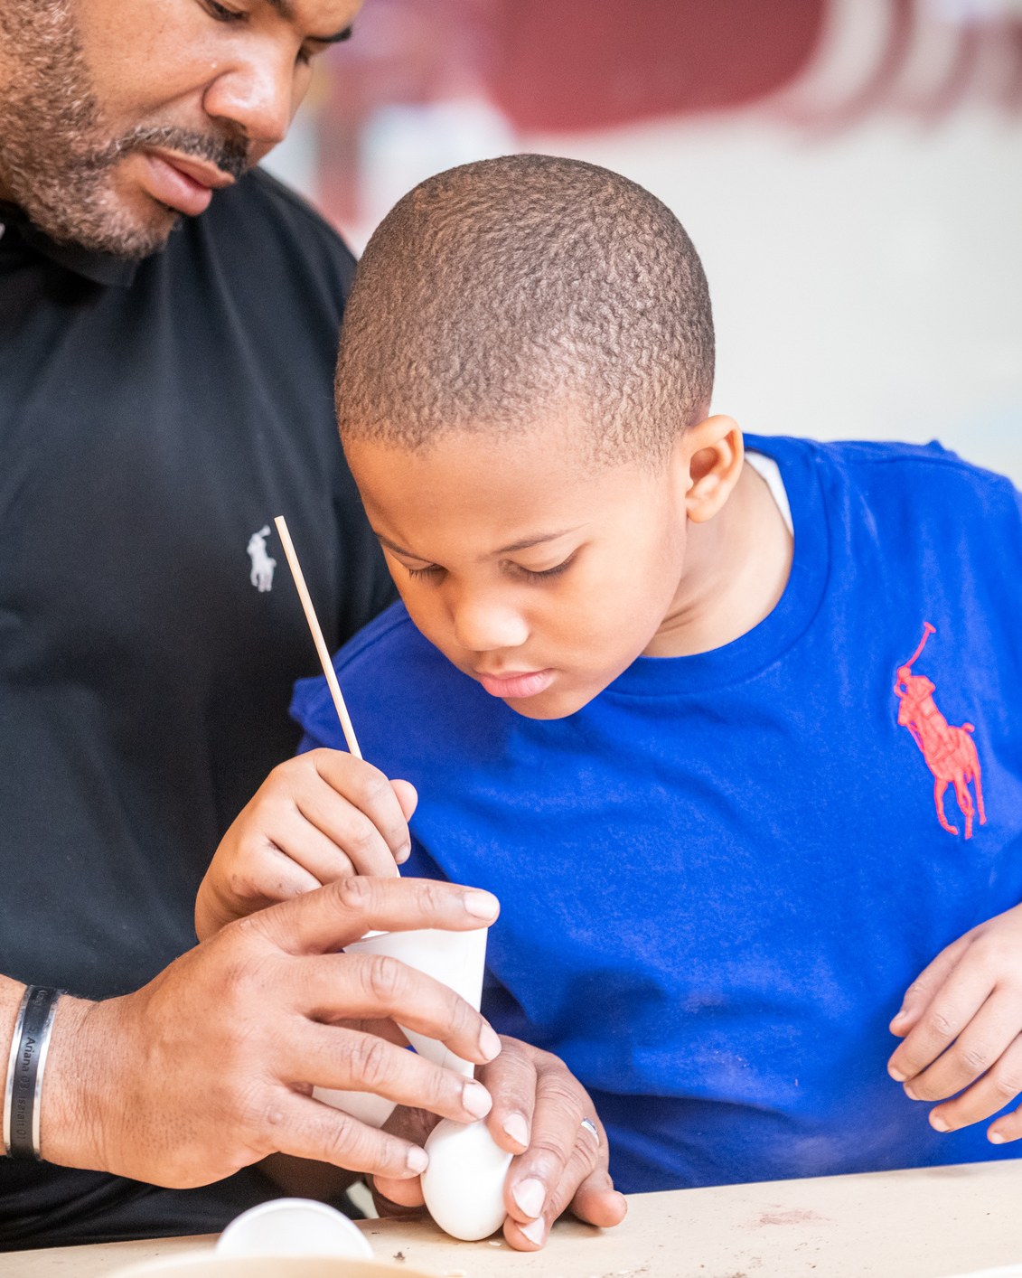




AGENDA
Introductions & Framing
Starting Activity
Skill Building Breakout Sessions
Elementary Cardboard Extravaganza
Middle School Micro:bit
Lunch (~12:15-1:00
Integrating Maker Learning
Project Share
Reflection & Next Steps

Slide 3
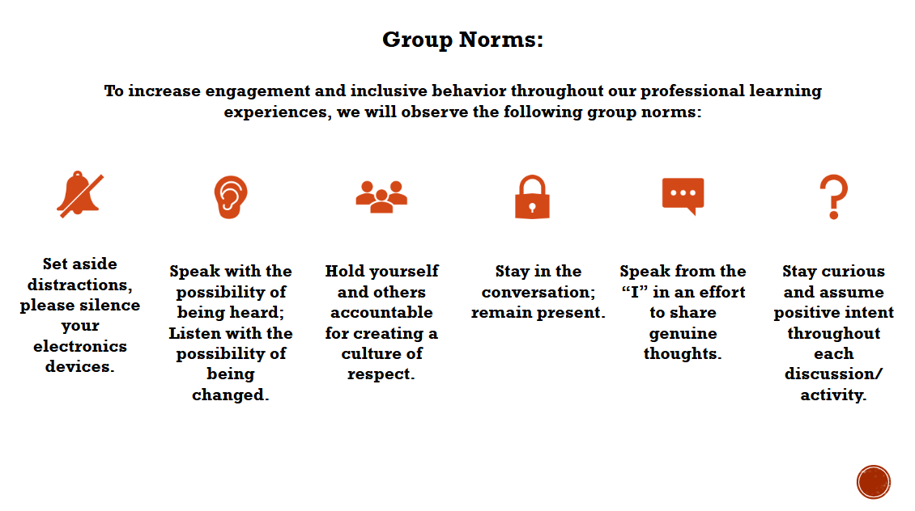

Slide 4
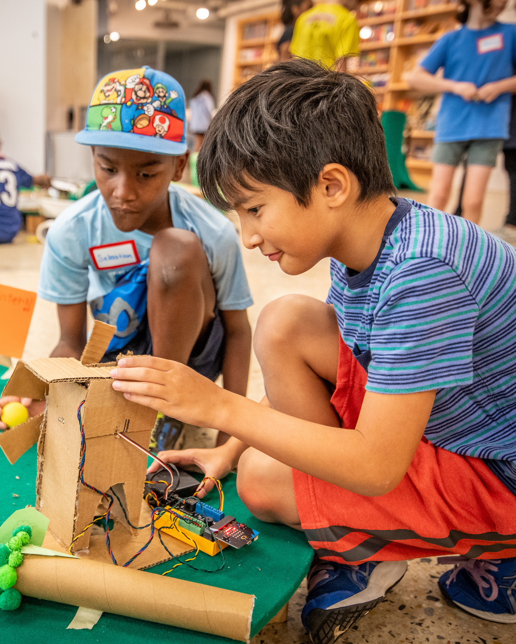
KID MUSEUM
A hub for innovation in teaching and learning
  KID Museum equips kids with the skills they need to invent the future.
  Our hands-on, experiential programs:
    Boost engagement and improve student outcomes
    Foster durable, critical thinking and creative problem solving skills
    Support teachers as changemakers

Slide 5

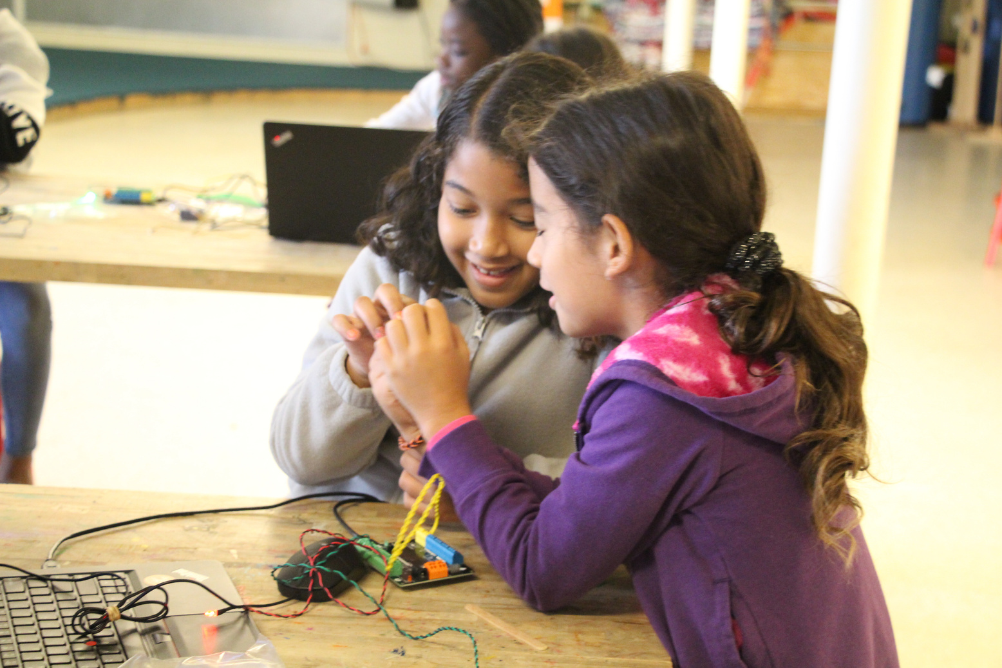
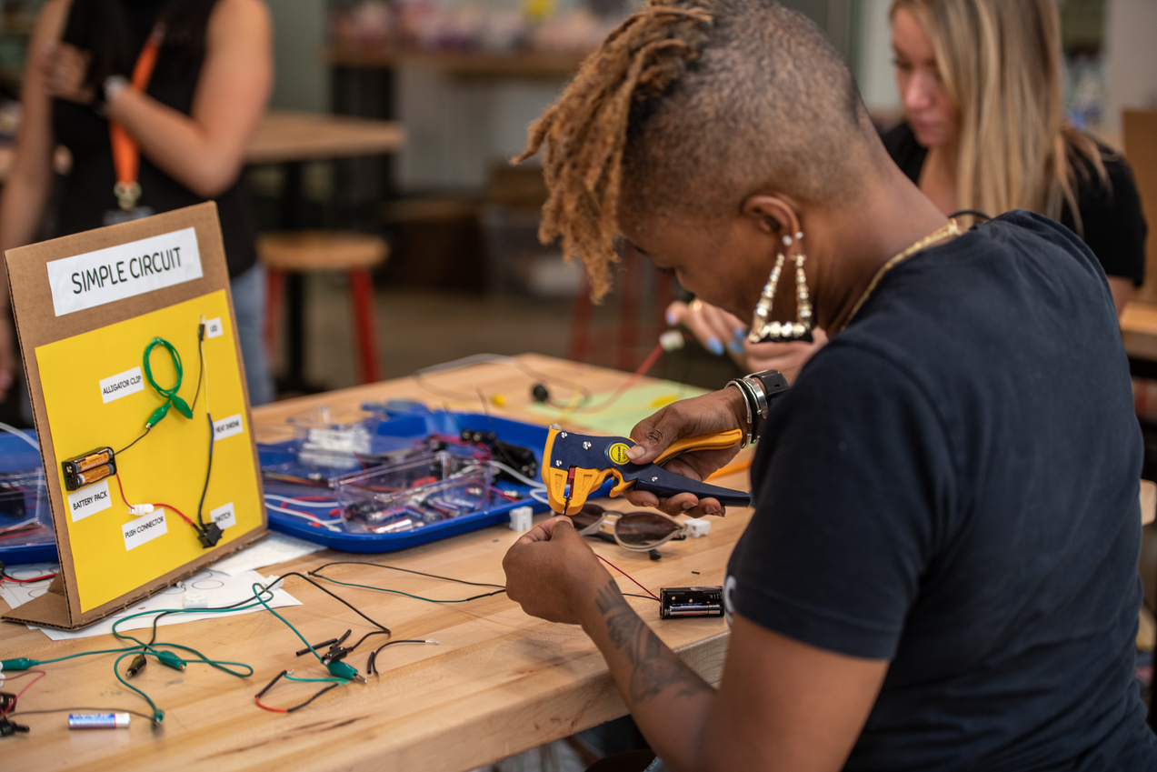
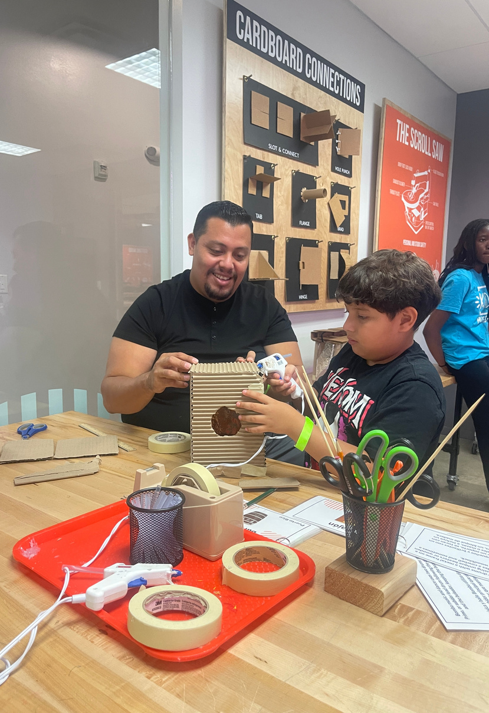

AN ECOSYSTEM OF LEARNING
Student programs
and curriculum
Teacher Professional
Development
Family Engagement & Out of School Time Learning

Slide 6
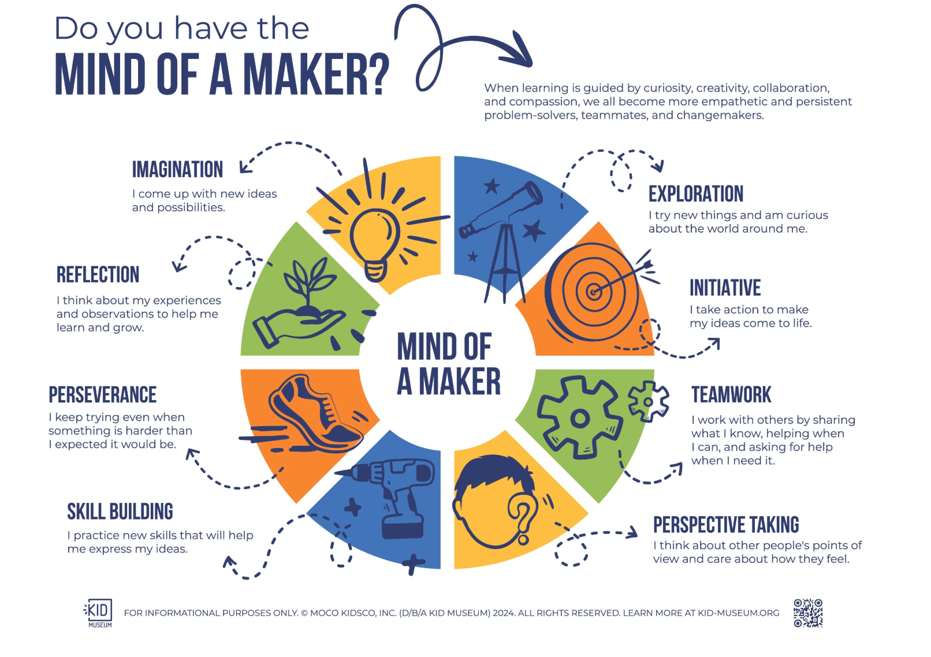

Slide 7
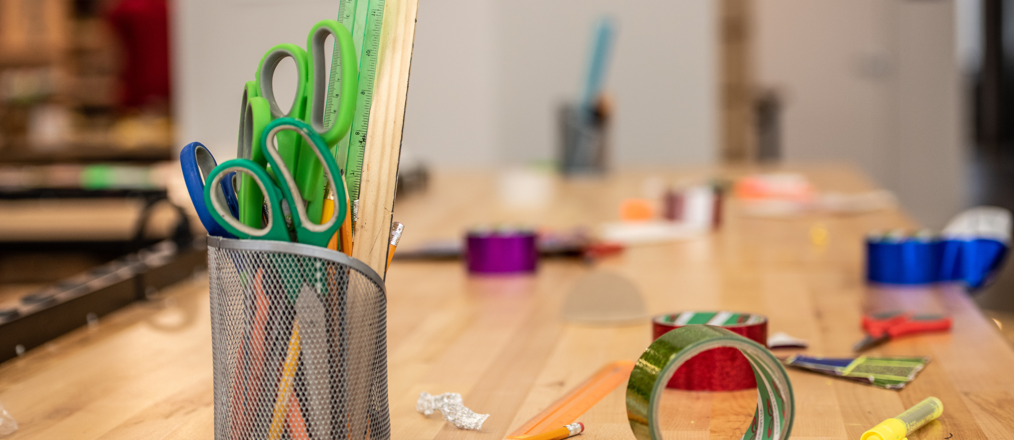


Elementary Cardboard and Paper Breakout Group

Slide 8


WARM UP ACTIVITY
Choose:
1 tool + 1 piece of paper Play or create
something with
your paper!

Slide 9
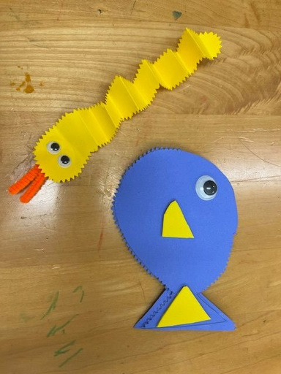

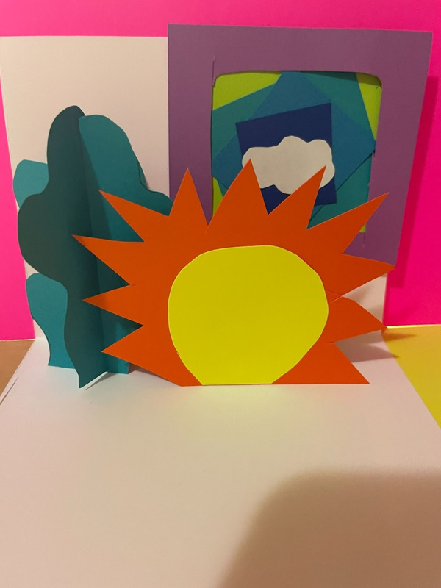
EXPLORATION: PAPER TECHNIQUES
#1 FOLD
  Explore folding techniques
  Try a 3D creature
#2 CUT
  Test out different tools to cut or punch
  Be inspired by papel picado
#3 COMBINE
  Experiment with folding and cutting
  Try out simple pop up designs

Slide 10
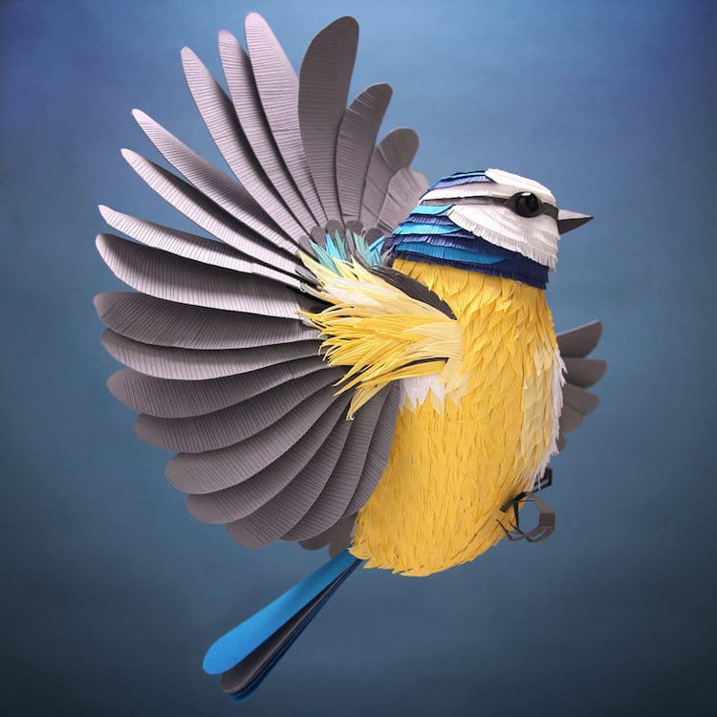


Slide 11
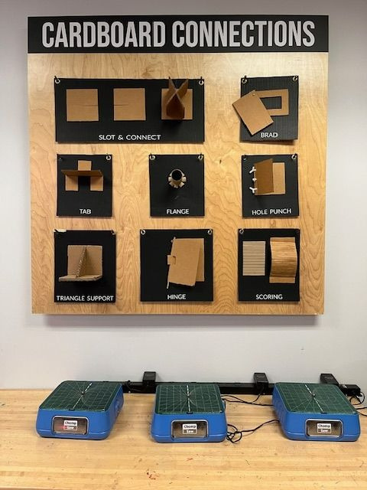
CARDBOARD CONSTRUCTION
BRAD ATTACHMENTS
STANDS
  Stands
  Triangle/ Gusset
  Slot and Connect
  Scoring
CIRCLES
  Trace and cut
  Punch

Slide 12
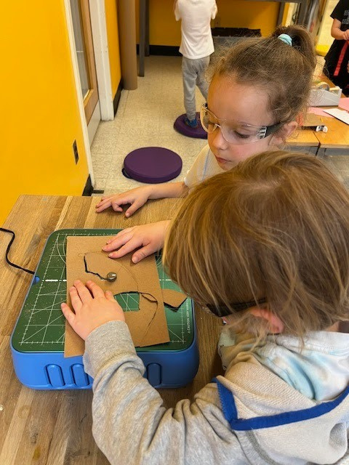

CHOMP SAW

Slide 13
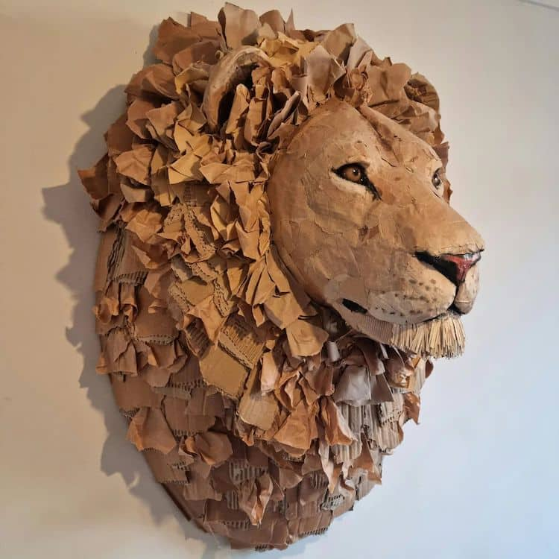
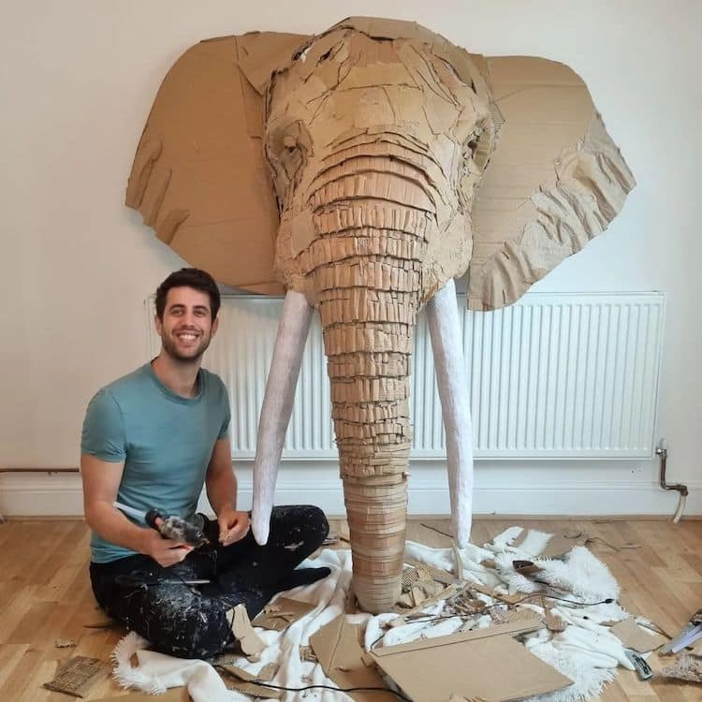

Slide 14
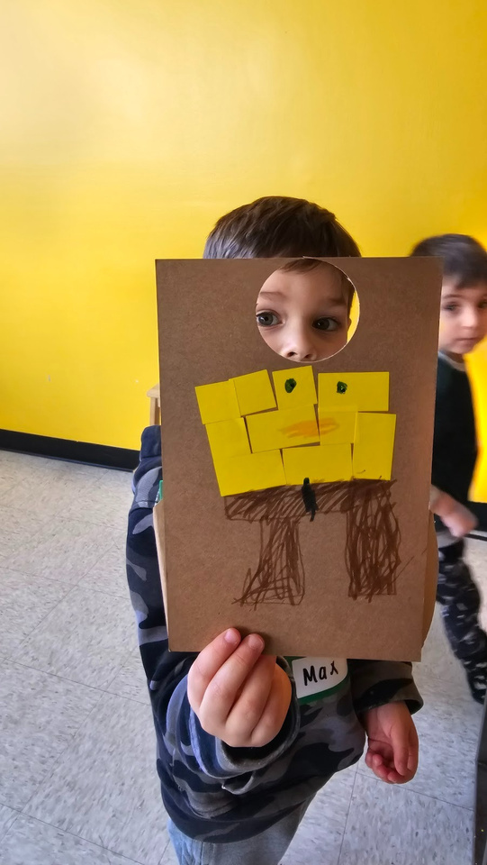
MAKER PROJECT DESIGN PROMPTS
#1 DESIGN AND BUILD A STAND UP GAME
  Design criteria:
    Collage or layer multiple materials
    Use at least 1 construction technique you learned today
  ELA Skills & Standards:
    Grade 1 Story Structure- character, setting, plot
    Grade 5 Plot Summary- sequence of events
#2 CONSTRUCT A HOLDER FOR ____ CUBES
  Challenge Cards:
    Create challenge cards to include additional design features
  Math Skills:
    Grade 4 Measurement/ Perimeter
    Grade 3/ 4 Writing equationS

Slide 15
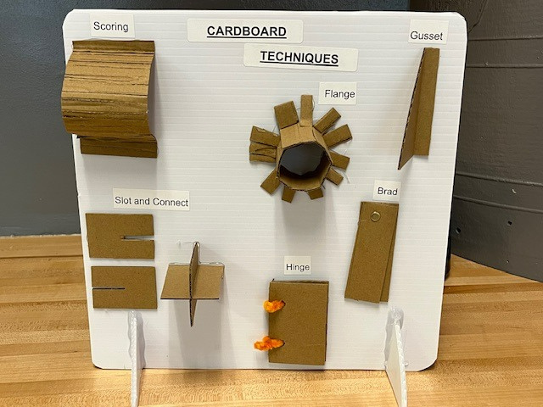

Slide 16
REFLECTION
  Think about ~10 minute snippets!
    What ideas do you have to incorporate making in small ways with your students?
  What mini maker projects/ prompts could you give students to allow them to practice skills and content?
  What extensions or other ideas do you have following this session?

Slide 17
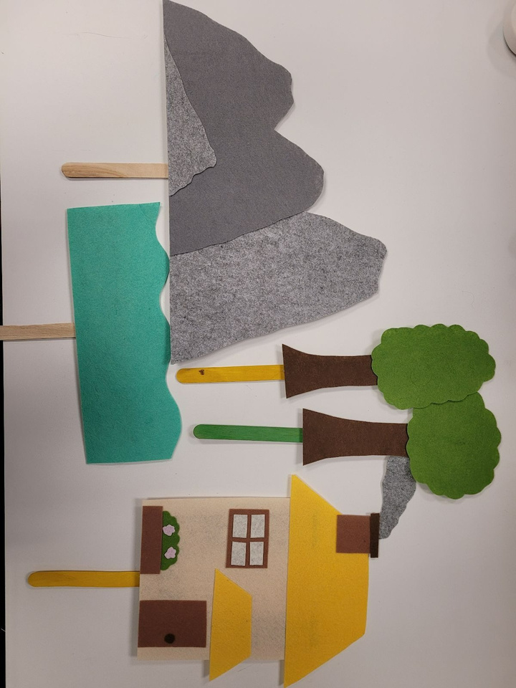
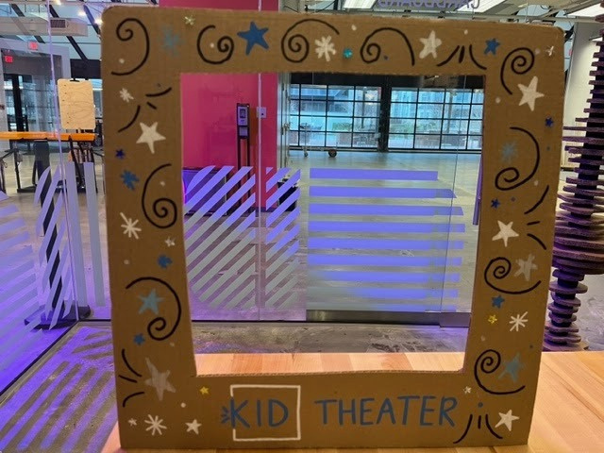
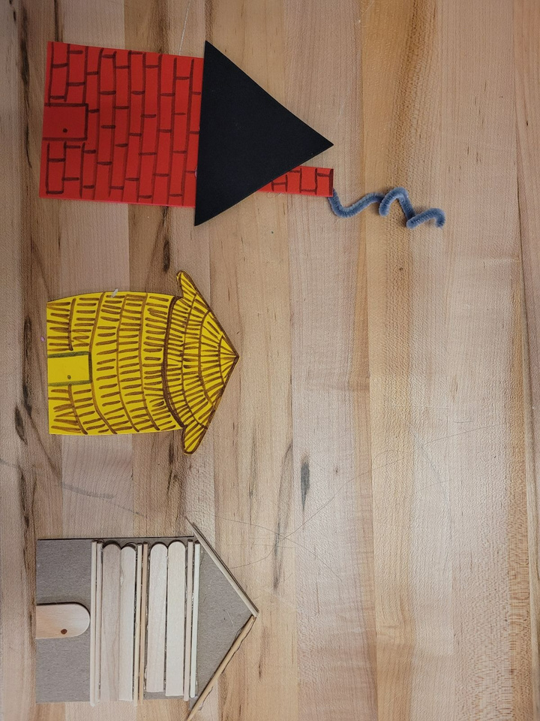
STORYTELLING

Slide 18
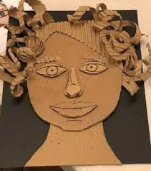
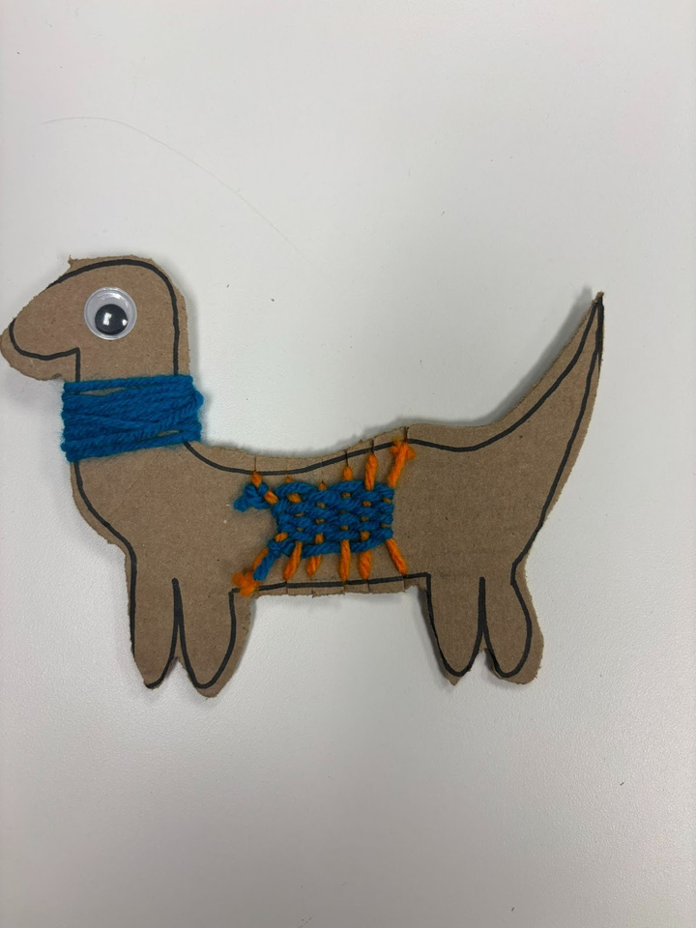
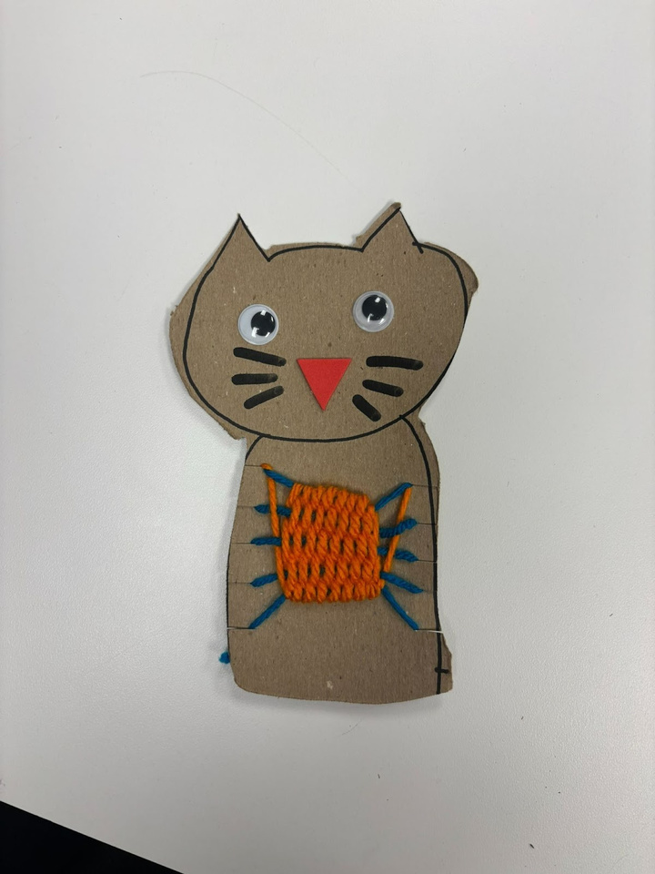
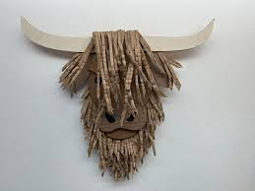
LOOMS AND COLLAGES

Slide 19
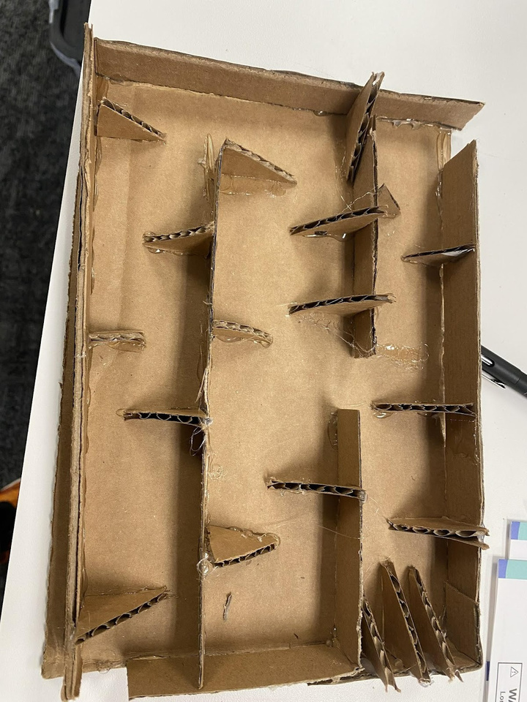
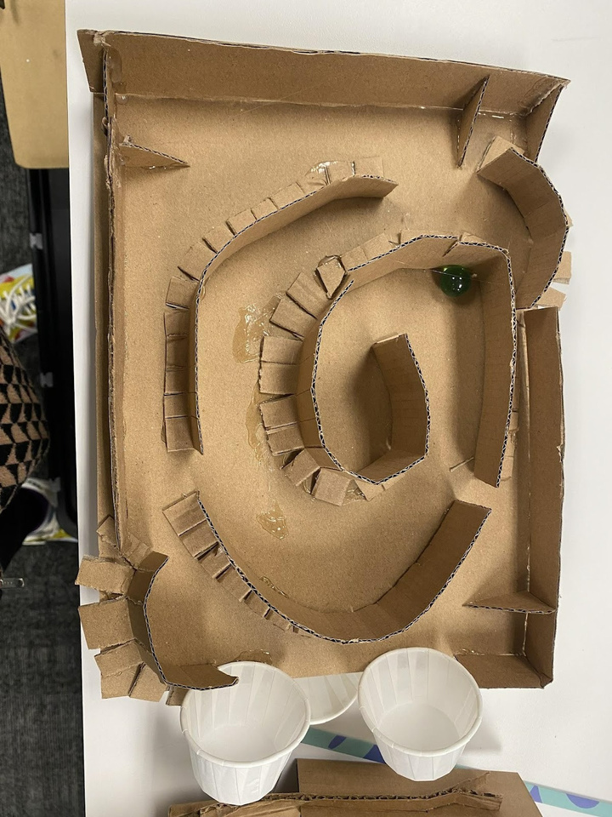
MARBLE RUN GAMES

Slide 20
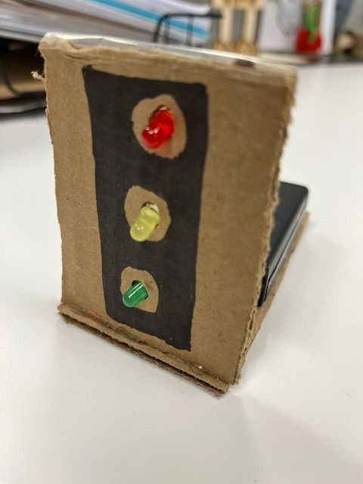
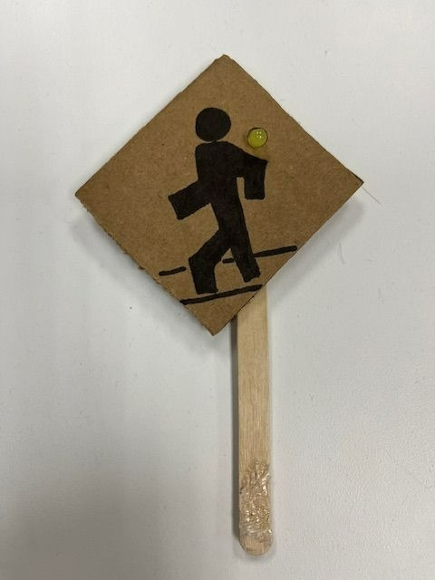
CITY SIGNS

Slide 21
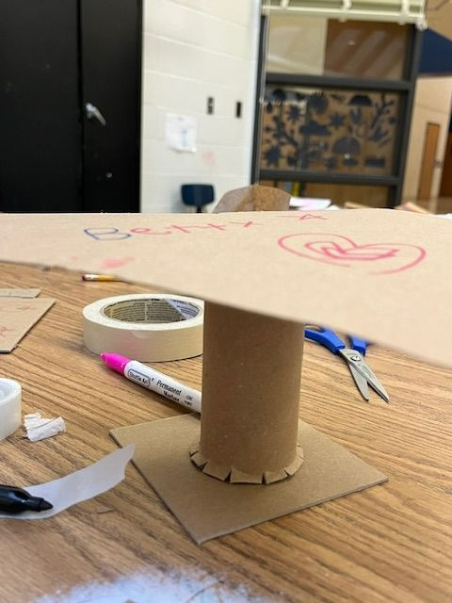
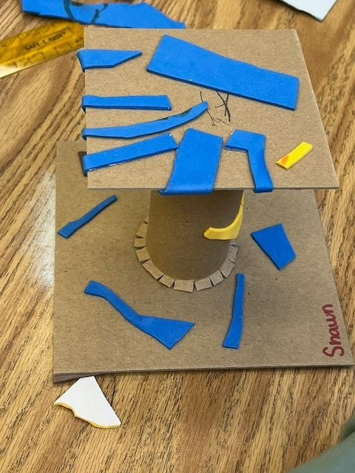
DISPLAY STANDS

Slide 22
5th-8th Grade Micro:bit Breakout Group

Slide 23
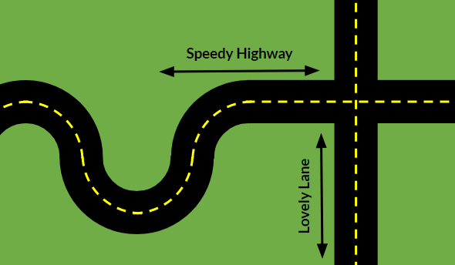
SPEEDY HIGHWAY AND LOVELY LANE CHALLENGE
The intersection of Speedy Highway and Lovely Lane has proven to be a very dangerous intersection in your community.
There have been several accidents in and around that intersection involving cars, pedestrians, and animals.
The mayor of the town has tasked your team with designing safety measures to reduce the number of incidents at the intersection.

Slide 24
SPEEDY HIGHWAY AND LOVELY LANE CHALLENGE
Goal:
Design and build safety measures for the intersection of Speedy Highway and Lovely Lane.
See your team’s handout for more design information

Slide 25
GROUP ACTIVITY

Slide 26
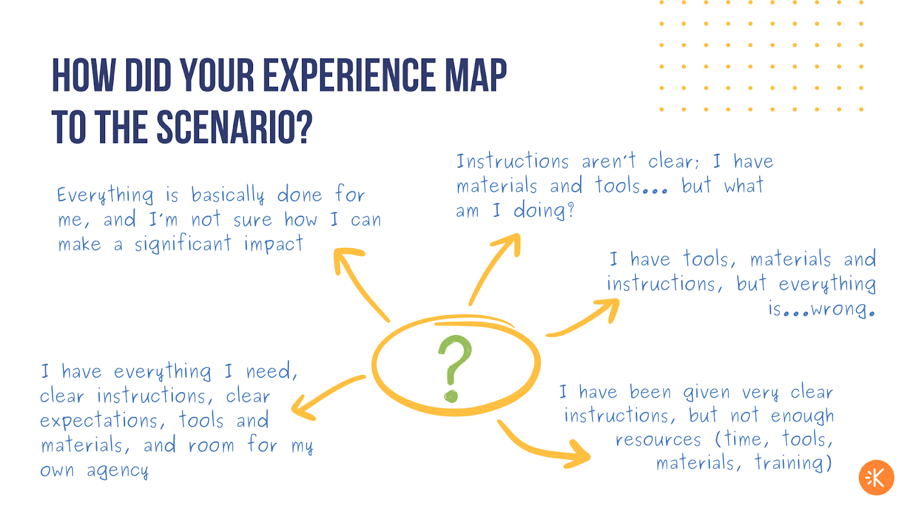

Slide 27
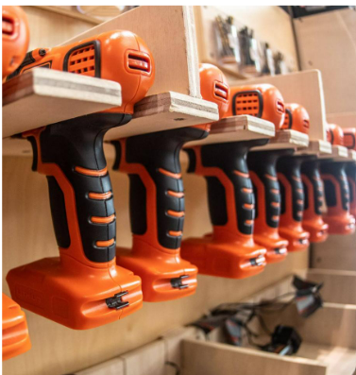

OUR DEFINITION
fail·ure (fāl-yər), noun:
When the outcomes of an experience do not meet the intentions of the individuals involved or task. Failures may be due to materials, tools, or other sources internal or external.

Slide 28
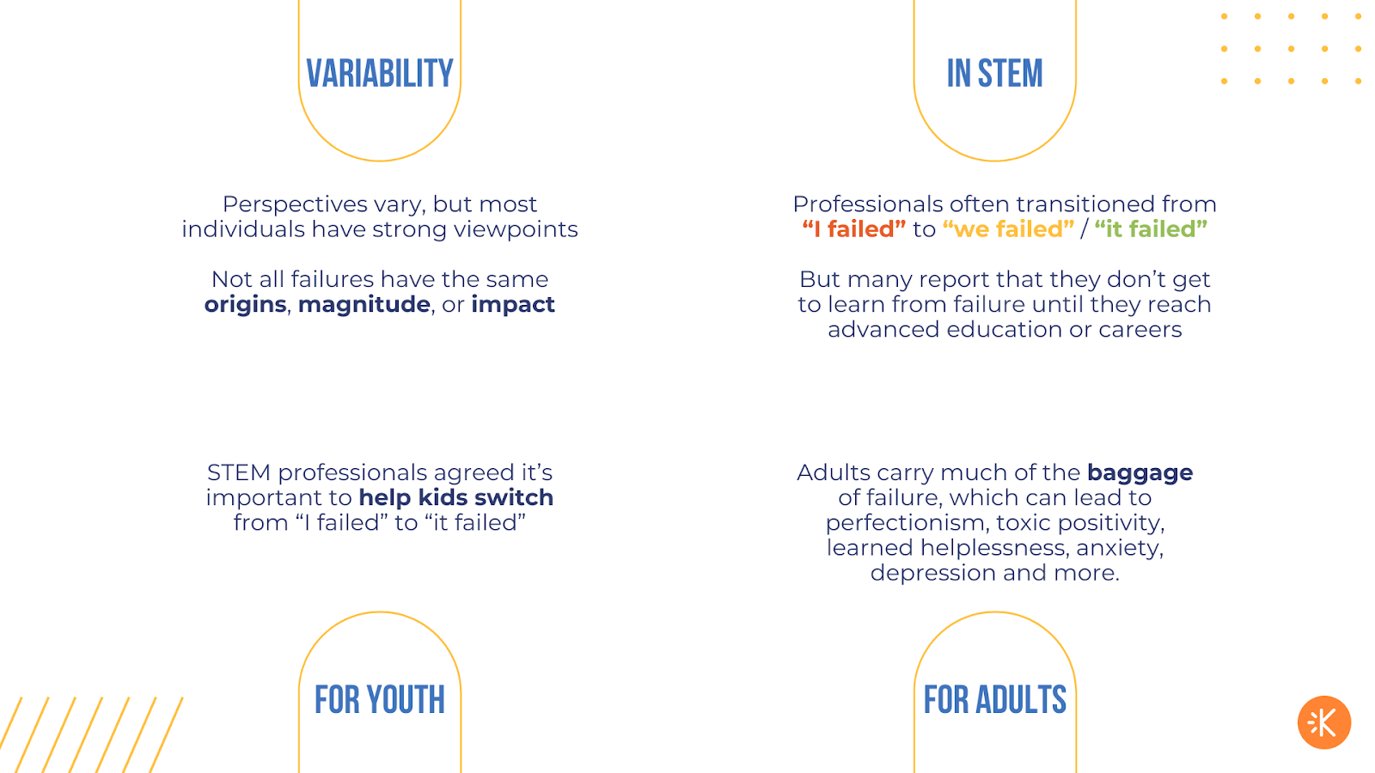
Professionals often transitioned from
“I failed” to “we failed / it failed”.
But many report that they don’t get to learn from failure until they reach advanced education or careers.
Adults carry much of the baggage of failure, which can lead to perfectionism, toxic positivity, learned helplessness, anxiety, depression, and more
STEM professionals agree it is important to help kids switch from “I failed” to “it failed”

Slide 29
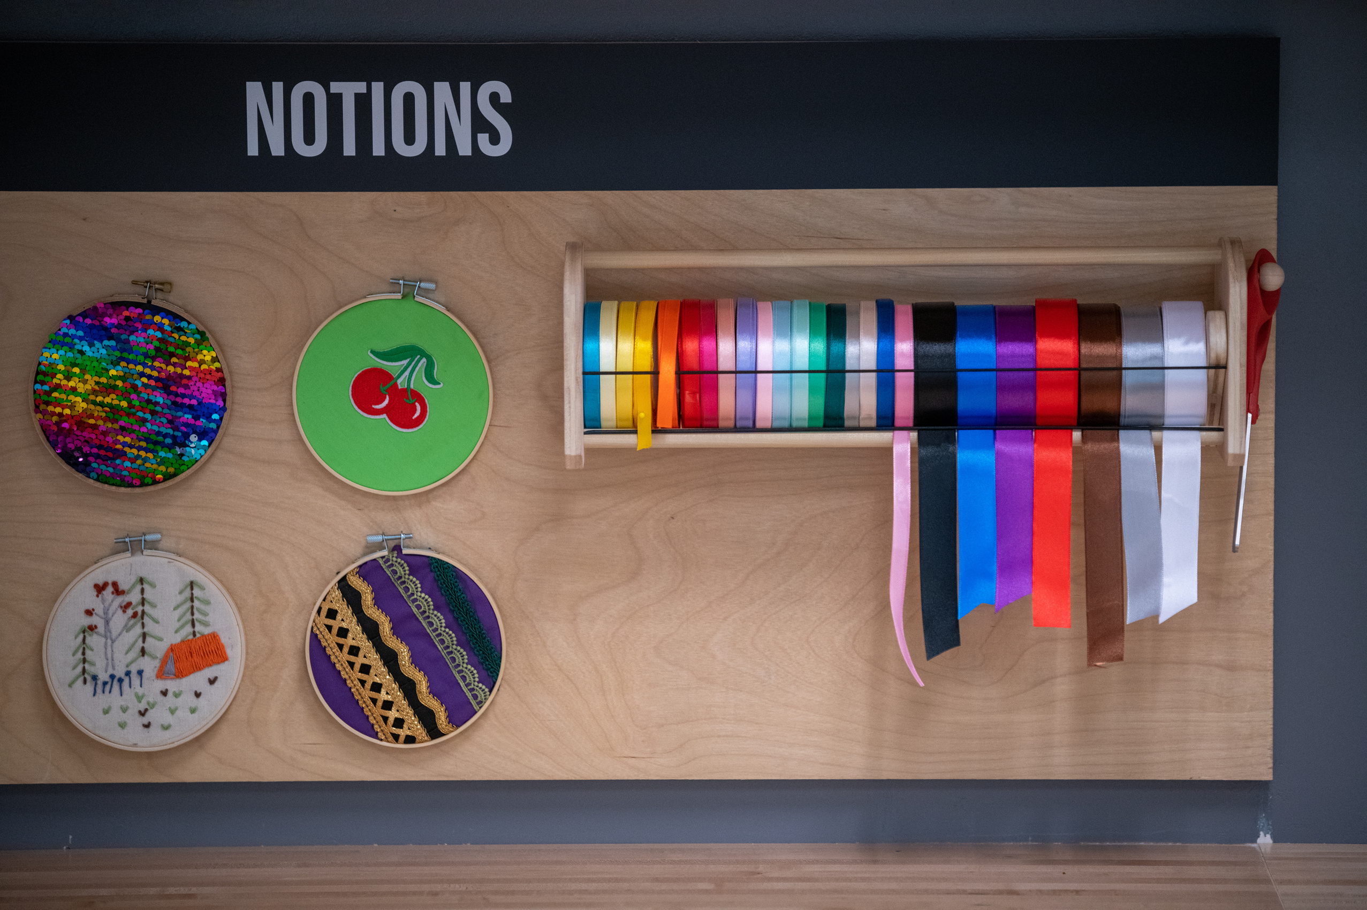

ARLINGTON TEACHER PROJECT SHARE

Slide 30
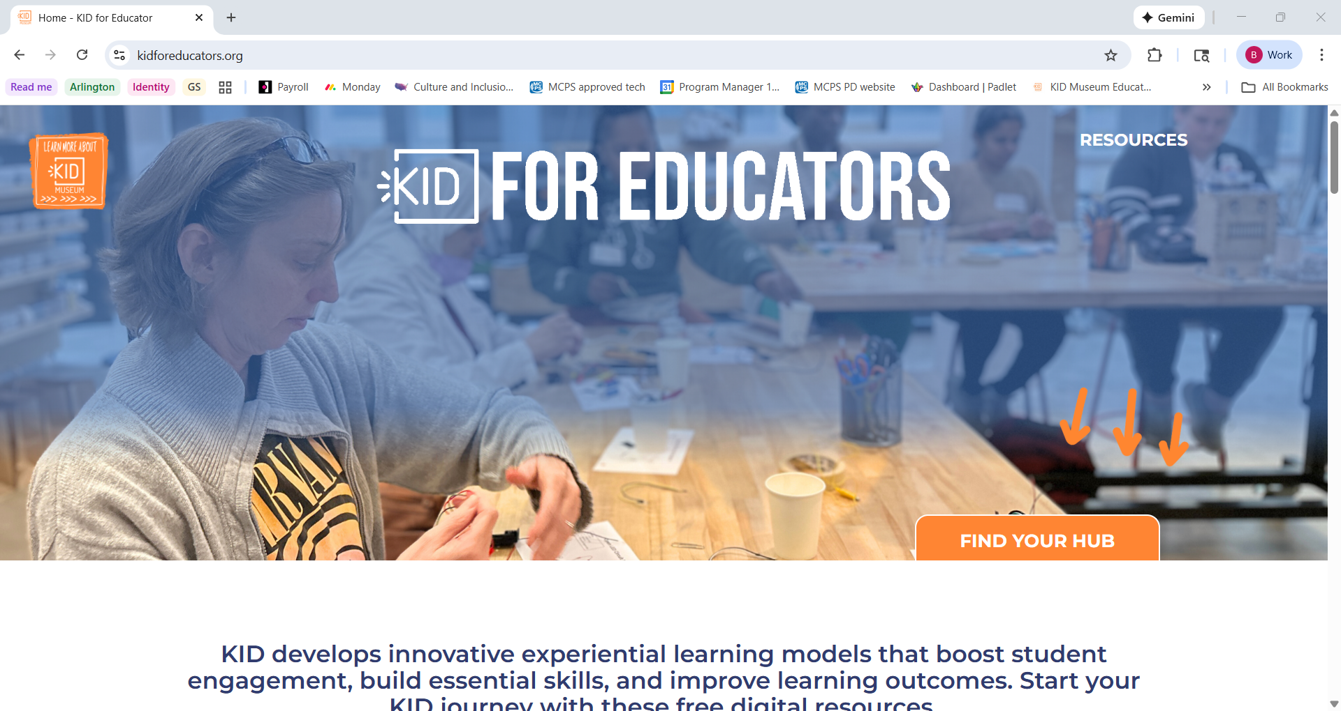

Slide 31
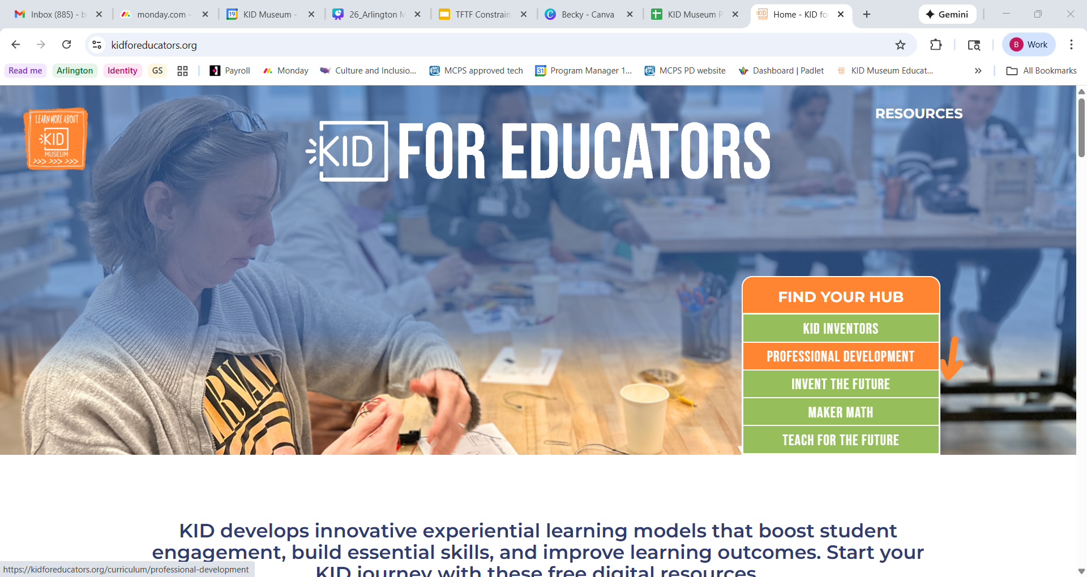


Slide 32
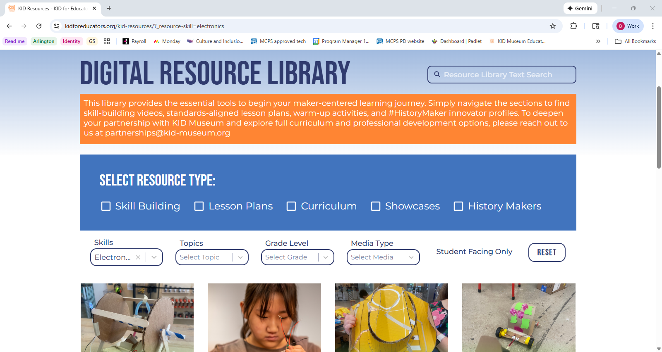

Slide 33
CLOSING SURVEY
Please complete your closing survey on Kickup

Slide 34
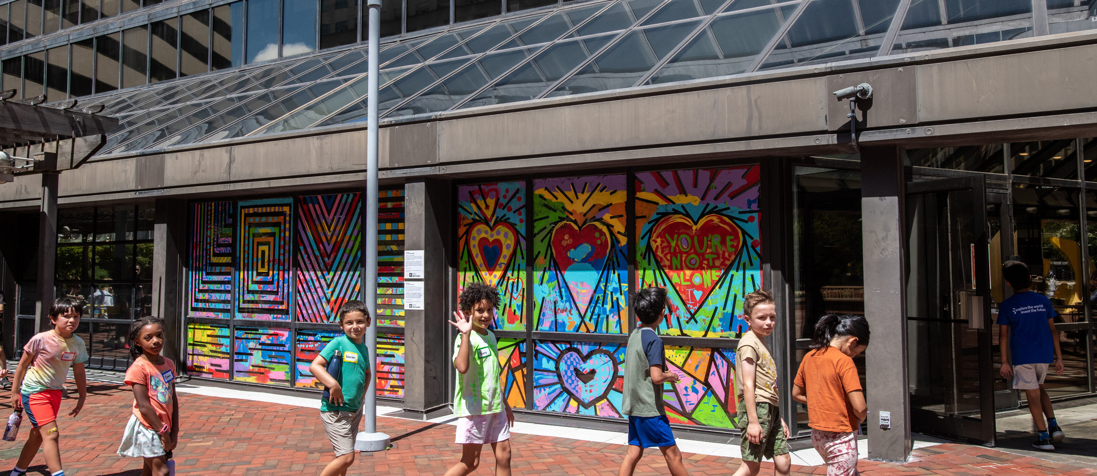
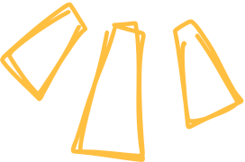







youtube.com/user/KIDMuseum
@kidmuseum
linkedin.com/company/kid-museum
@KIDMuseumMD
Interested in more info about teacher PD? Sign up for our educator newsletter!
facebook.com/KIDMuseum
Becky Zeisel, Savannah Fetterolf, Kate Loux
MakerPD@kid-museum.org

